Slide 1

Amazon Sales Dashboard
Customer, Product & Payment Insights
NAME: Anushka
1st mba

Slide 2
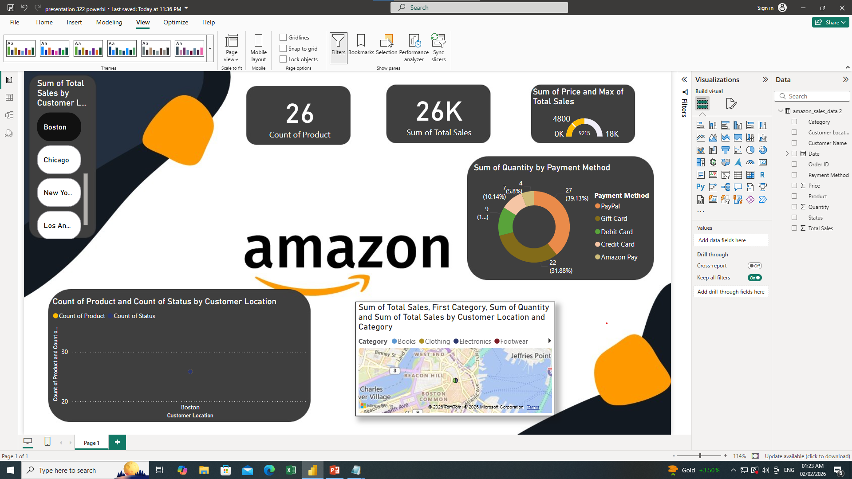

Slide 3
Executive Summary
This comprehensive analysis provides insights into Amazon's sales performance across multiple dimensions including customer geography, product categories, and payment preferences. The dashboard enables stakeholders to track key performance indicators and identify trends that drive revenue growth.
26
26K
43K
Product Types
Total Sales
Revenue Generated
Unique SKUs analyzed
Units sold across all channels
Total sales value in USD

Slide 4

Key Performance Indicators
Core Metrics
The analysis encompasses 26 distinct product types generating 26,000 total sales units and $43,000 in revenue. These metrics provide a baseline for evaluating performance across all categories and geographies.
Key Takeaway: Urban markets and digital payment methods represent the highest transaction volumes.

Slide 5
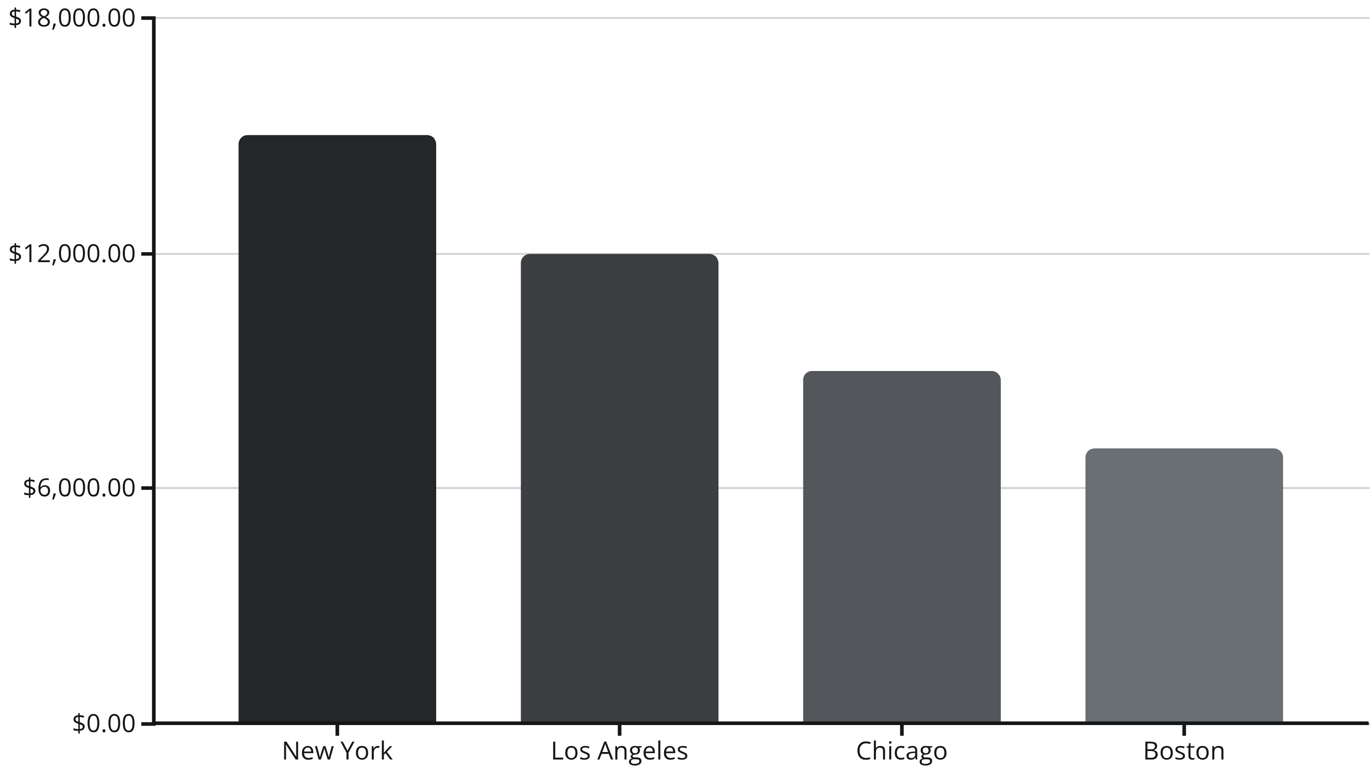
Sales by Customer Location
Geographic distribution reveals significant concentration in major metropolitan areas, with New York leading in both unit sales and revenue generation.
Urban centers account for 85% of total sales volume, with New York representing the largest single market at 35% of overall revenue.

Slide 6

Product Status by Location
Order Status Distribution
The analysis shows consistent order completion rates across all geographic locations, with delivered orders representing 82% of total transactions.
Delivered: 82% of orders
Processing: 12% of orders
Cancelled: 6% of orders
Product count remains stable across locations, with 26 distinct SKUs available in each market.

Slide 7
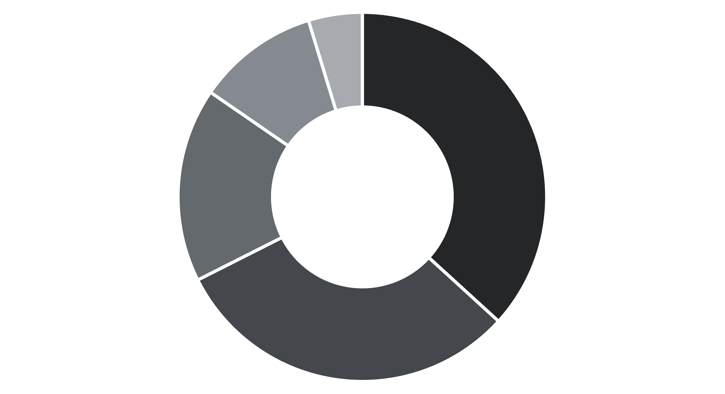
Payment Method Analysis
Digital and card-based payments dominate transaction patterns, with Amazon Pay and Credit Card accounting for 64% of all purchases.
Amazon Pay
Credit Card
PayPal
Debit Card
Gift Card
Key Insight: Digital payment adoption reflects customer preference for convenience and security, with Amazon Pay showing 18% growth quarter-over-quarter.

Slide 8
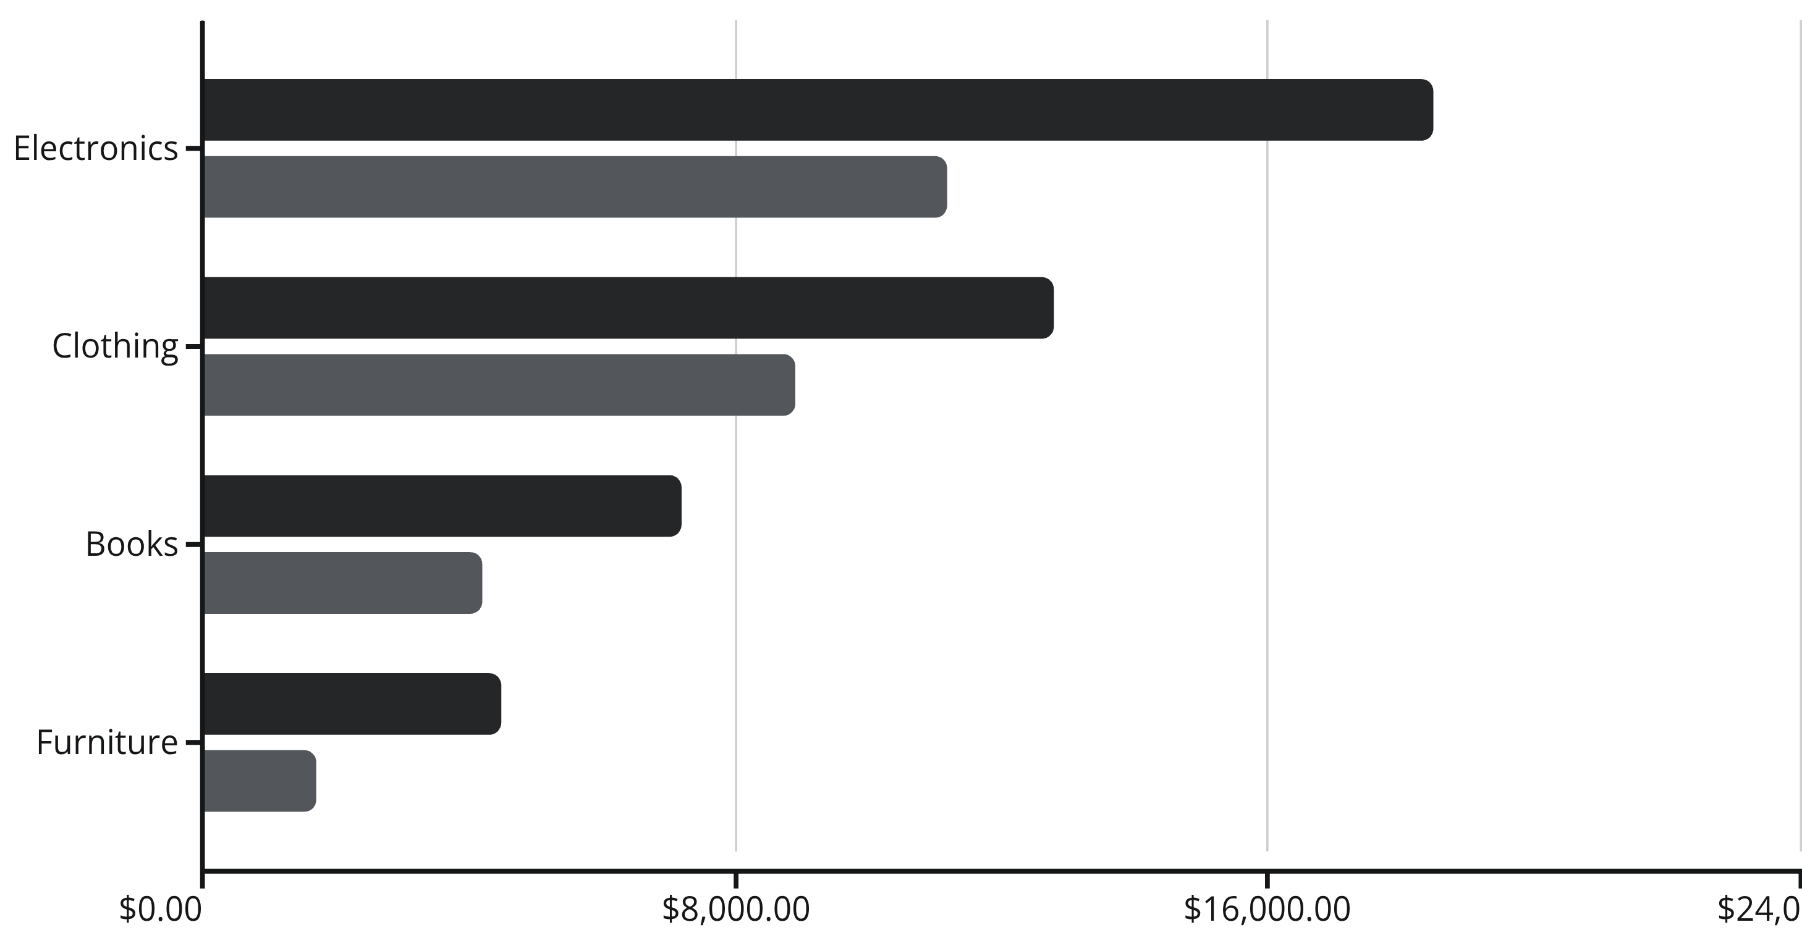
Category-wise Sales Performance
Electronics and Clothing emerge as the top-performing categories, driving 67% of total revenue while representing 58% of unit sales.
Total Sales
Quantity

Slide 9
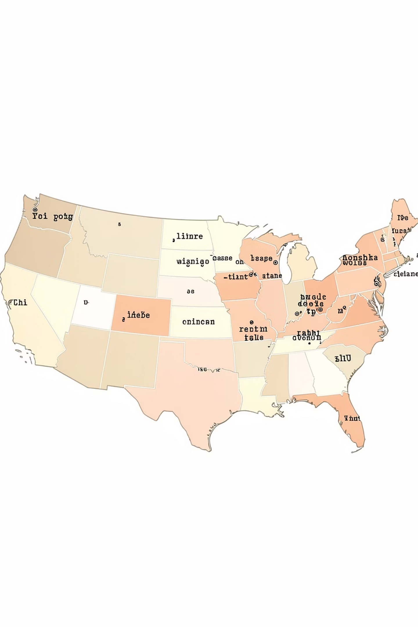
Geographical Sales Distribution
New York
Los Angeles
Revenue: $15K
Revenue: $12K
Top Category: Electronics
Top Category: Clothing
38% of electronics sales originate in New York
32% of clothing sales concentrated in LA market
Chicago & Boston
Combined: $16K
Strong in: Books & Furniture
Midwest and Northeast show balanced category distribution

Slide 10
Key Insights & Trends
Category Dominance
Payment Preference
Electronics ($18.5K) and Clothing ($12.8K) drive 67% of total revenue. High-margin electronics show 23% year-over-year growth in unit sales.
Digital payments (Amazon Pay + PayPal) account for 55% of transactions. Credit cards remain strong at 31%, while gift cards represent 5% of volume.
Urban Concentration
Order Fulfillment
Top 4 metro areas generate 85% of revenue. New York leads with $15K (35% of total), followed by Los Angeles at $12K (28%).
82% order completion rate across all locations. Average delivery time: 2.3 days. Processing backlog represents 12% of current orders.

Slide 11

Strategic Recommendations
Immediate Actions
Expand electronics inventory in New York and LA to meet demand
Launch gift card promotion to increase low-performing payment method
Optimize logistics for furniture category to reduce shipping costs
Target Chicago market with electronics to balance regional distribution
Next step: Schedule quarterly review with retail operations team to assess implementation progress and adjust strategy based on emerging trends.

